Slide 1
Task Analysis
(TA)

Slide 2
Definition of terms
An Activity or an Element: A Job element is the unit into which work can be divided.
A task is a distinct set of work activity carried out for a distinct purpose. For example, room rent costing is a task of front office executive.
A duty is number of tasks. example, front office executive's duties include meeting‘ and welcoming the client and explaining the features of the hotel and its surroundings.

Slide 3
A position refers to one or more duties performed by one person in an organisation. There are at least as many positions as there are workers in the organisation, vacancies may create more positions than employees.
is a type of position within an organisation. For example, a hotel may employ a dozen front office executives, then there are a dozen positions but just one front office executive job.

Slide 4
Task analysis can be defined as the process of identifying the tasks of a particular job in a particular organizational context by analyzing activities, establishing performance criteria, determining required competencies, and analyzing any discrepancies uncovered by this process:

Slide 5
Guidelines to Task Analysis
Analysis should be under taken only after developing an understanding of a particular organizational context involved.
The job, should be broken down into specific activities performed and expected to be performed by the jobholder or incumbent.
The activities should be grouped into tasks. A is a set of related activities –
    a .function that makes a distinct contribution to organizational goals.

Slide 6
Performance criteria and their indicators should be established.
The competencies required for the effectiveness of each task should be identified.
The discrepancies between perceived and actual performance and between important attributes and important reflection in time spent be identified.

Slide 7
TA & GOMS
Both are members of the same family of analysis techniques.
Task Analysis(TA) covers a wide area of study.
Goals, operators, methods and selection (GOMS)
Actual distinction between TA, GOMS and others is what it aims to represent:
  Cognition of Task (GOMS)
  Practice of Task (HTA)
  Logic of Task (CTA)

Slide 8
One method is to count keystrokes and mental operations (decisions) for the tasks the design is intended to support. This will allow you to estimate task times and identify tasks that take too many steps. The procedures for this approach, called GOMS (Goals, operators, methods and selection rules used in usability testing) analysis, along with average times for things like decisions, keystrokes, mouse movements, etc. have been developed in considerable detail.

Slide 9
Another method is to use a technique called the Cognitive Walkthrough to spot places in the design where users might make mistakes. The cognitive walkthrough analyzes users' interactions with the interface as they perform specific tasks.

Slide 10
GOMS
GOMS analysis of human-system interaction can be applied a various levels
  The GOMS model, which describes the general methods for accomplishing a set of tasks
  The unit task level, which breaks users’ tasks into unit tasks, then estimates the time that it takes for the user to perform these.
  Keystroke level, which describes and predicts the time it takes to perform a task

Slide 11
TA & GOMS
GOMS - Cognitive task analysis is knowledge- focused
  Knowledge structures.
  Language.
  Cognitive/perceptual actions.
  Reveals internal representation and processing associated with interface.
TA is behavior-focused
  What the user wants to do.
  What the user does do, applied to existing systems

Slide 12
Task Analysis - What’s a Task?
A set of human actions that contributes to a functional objective and to the goal of the system.
Scope or size of a task is determined by the definition of the objectives.
Each task should be approximately equal in size.
  But not always the case

Slide 13
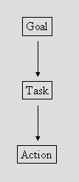
Task - Decomposition

Slide 14
The difference is ...
Goal - state of the system that a human wants to accomplish.
Task - activities required, used, or deemed necessary to achieve a goal.
Actions - steps required to complete the task.

Slide 15
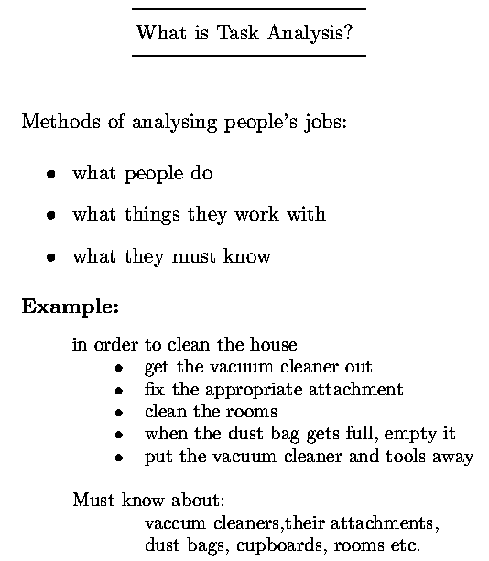

Slide 16
Steps for Task-Analysis process:
The steps for task-analysis process are as follows:
figure out who's going to use the system and to do what
choose representative tasks for task-centered design
plagiarize
rough out a design
think about it
create a mock-up or prototype
test it with users
iterate
build it
track it
change it

Slide 17
Task Analysis vs…...
Engineering requirements analysis defines performance required of hardware.
Programming specifications define performance of software.
Task analysis defines performance of humans.

Slide 18
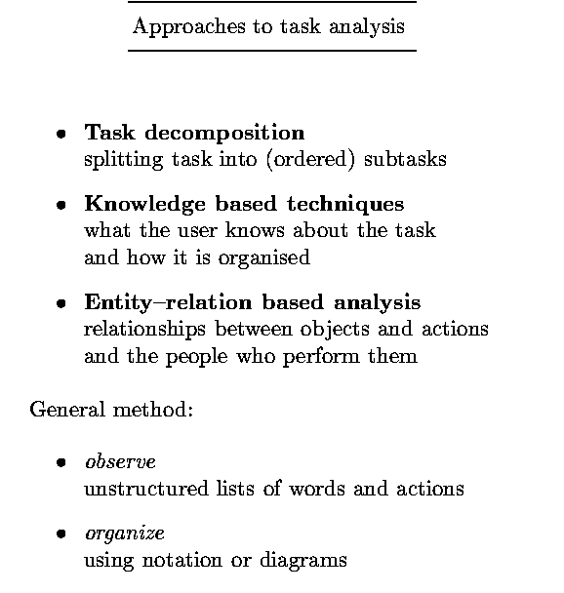

Slide 19
Task Decomposition
Aims:
  describe the actions people do
  structure them within task subtask hierarchy
  describe order of subtasks
  describes existing systems

Slide 20
Focus on Hierarchical Task Analysis (HTA)
It uses:
text and diagrams to show hierarchy
plans to describe order

Slide 21
Practical Task Analysis
Develop concrete, detailed examples of tasks, users perform or want to perform.
Determine what the user wants to do, not how to do it.
  No assumptions about interface ??????
  Allows design alternatives
  Task descriptions are very specific
  Task descriptions are context-specific
  Task descriptions are user-specific

Slide 22
Textual HTA description
Hierarchy description ...
  0. in order to clean the house
    1. get the vacuum cleaner out
    2. fix the appropriate attachment
    3. clean the rooms
      3.1. clean the hall
      3.2. clean the living rooms
      3.3. clean the bedrooms
    4. empty the dust bag
    5. put vacuum cleaner and attachments away

Slide 23
Plans
... and plans
  Plan 0: do 1 - 2 - 3 - 5 in that order. when the dust bag gets full do 4.
  Plan 3: do any of 3.1, 3.2 or 3.3 in any order depending on which rooms need cleaning
Note: only the plans denote order

Slide 24
Generating the hierarchy
  get flat list of tasks
  group tasks into higher level tasks
  decompose lowest level tasks further
Stopping rules How do we know when to stop?
  Is “empty the dust bag" simple enough?
Purpose: expand only relevant tasks.
Error cost: stop when P x C is small
  Probability of making an error X cost of the error
Motor actions: lowest sensible level

Slide 25
Diagrammatic
HT
A
Line under box means no further expansion.
Plans shown on diagram or written elsewhere.
0.
make
a
cup
of
tea
plan
0.
do
1
at
the
same
time,
if
the
pot
is
full
2
then
3
-
4
after
four
or
five
minutes
do
5
1.
2.
3.
4.
5.
6.
boil
water
empty
pot
put
tea
leaves
pour
in
wait
4
or
5
pour
tea
in
pot
boiling
water
minutes
plan
1.
1.1
-
1.2
-
1.3
when
kettle
boils
1.4
1.1.
1.2.
1.3.
1.4.
fill
kettle
put
kettle
wait
for
kettle
turn
off
gas
on
stove
to
boil
#
Line
under
b
o
x
means
no
further
expansion.
#
Plans
sho
wn
on
diagram
or
written
elsewhere.
#
Same
information
as:
0.
mak
e
a
cup
of
tea
b
w
ater
1.
oil
:
:
:
Human{Com
puter
In
teraction,
Pren
tice
Hall
T
ask
Analysis
fl
A.
Dix,
J.
Finla
y
,
G.
Ab
o
wd
and
R.
Beale
c
1993
Chapter
7
(8)

Slide 26
Refining the description
Given initial HTA (textual or diagram)
  How to check/improve it?
Some heuristics:
  paired actions
    e.g., where is `turn on gas'
  restructure
    e.g., generate task `make pot'
  balance
    e.g., is `pour tea' simpler than making pot?
  generalize
    e.g., make one cup or two ... or more

Slide 27
Refined
HT
A
for
making
tea
Redefined HTA For Making Tea
0.
make
cups
of
tea
plan
0.
do
1
at
the
same
time,
if
the
pot
is
full
2
then
3
-
4
after
4/5
minutes
do
5
1.
2.
3.
4.
wait
4
or
5
5.
boil
water
empty
pot
make
pot
minutes
pour
tea
plan
5.
empty
NO
for
each
5.1
5.2
cups
?
guest
5.3
plan
1.
YES
1.1
-
1.2
-
1.3
-
1.4
when
kettle
boils
1.5
5.1.
5.2.
5.3.
put
milk
fill
cup
do
sugar
in
cup
with
tea
plan
3.
plan
5.3.
3.1
-
3.2
-
3.3
5.3.1
-
if
wanted
5.3.2
3.1.
3.2.
3.3.
5.3.1.
5.3.2.
put
tea
leaves
pour
in
ask
guest
add
sugar
warm
pot
in
pot
boiling
water
about
sugar
to
taste
1.1.
1.2.
put
kettle
1.3.
1.4.
1.5.
fill
kettle
on
stove
turn
on
and
wait
for
kettle
turn
off
gas
light
gas
to
boil
Human{Com
puter
In
teraction,
Pren
tice
Hall
fl
T
ask
Analysis
A.
Dix,
J.
Finla
y
,
G.
Ab
o
wd
and
R.
Beale
c
1993
Chapter
7
(10)

Slide 29
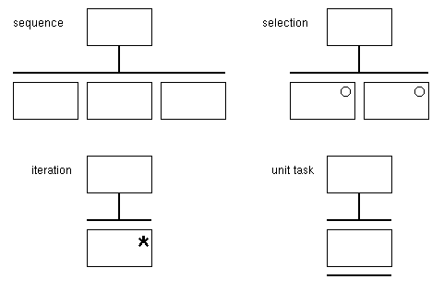
HTA Structure Chart Notation

Slide 30
Stages of a HTA
1. Starting the analysis
  a) Specify the main task.
  b) Break down main task into 4-8 subtask, and specify in terms of objectives. Cover the whole area of interest
  c) Draw out as layered plans, logically & technically correct. None should be missing.

Slide 31
2. Progressing the analysis
  a) Decide on level of detail and stop decomposition. Should be consistent between tasks. Can range from detailed to high level description.
  b) Decide if a depth first or breadth first decomposition should be done. Can alternate between the two.
  c) Label and number the HTA.

Slide 32
3. Finalizing the analysis.
  a) Check that decomposition and numbering is consistent. May produce a written account of the processes.
  b) Have a second person look it over. They should know the tasks but not be involved in the analysis.

Slide 33
Uses of Task Analysis
Helps the designer to identify neglected tasks in a work unit
Helps the designer to plan task delegation
  Setting individual tasks for a specific period
  Helping a user to decide priorities of task
  Minimizing overlap between jobs
Job enrichment

Slide 34
Assumptions about the interface
Must be made to fulfill the system requirements.
  Very true if we are describing how users behave on an existing system.
Should not be made when we are designing a new system.
  Don’t limit our options before we start.

Slide 35
Assign 5
Come up with a HTA for preparing Ugali and map out at least 2 plans. (Do both the textual and sequence diagram)

